Slide 1
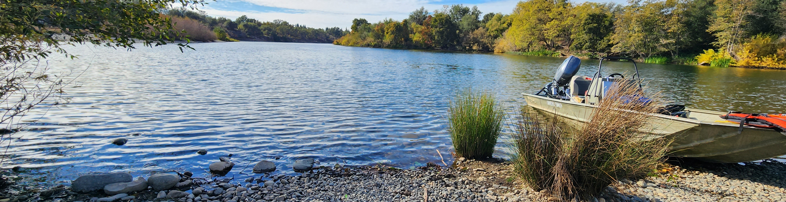

Scale sampling and analysis for cohort reconstruction
June 12th, 2026

Slide 2
Outline
Review of sample size determination
Scale selection methods
Scale collection from escapement surveys.
Estimating survey location abundance.
Estimating locations contribution to basin abundance.
Selection of scales for aging.
Pooling and aging scales from across the basin.
GitHub: https://github.com/arthurbarros-CDFW/CR_sampling

Slide 3
Cohort Reconstruction (CR) in the Sac Basin
Context: efforts are underway to implement age-structured Cohort Reconstruction (CR) for the Sacramento R. basin to replace/compliment the Sacramento Index.
Challenge: accurately estimating natural-origin Sacramento River fall-run Chinook Salmon (SFCS) escapement by age.
Initial question: How many scales are needed to accurately estimate natural-origin age-class proportions?
Notes:
To set the stage and context for these efforts, we are undertaking efforts to implement age-structured cohort reconstruction to replace/compliment the Sacramento Index. One of the big challenges of this effort is accurately estimating the escapement of natural-origin sacramento fall-run chinook salmon for each age group. The initial question tasked with was determining how many scales we needed to collect and age to accurately produce this estimate of natural-origin fish.

Slide 4
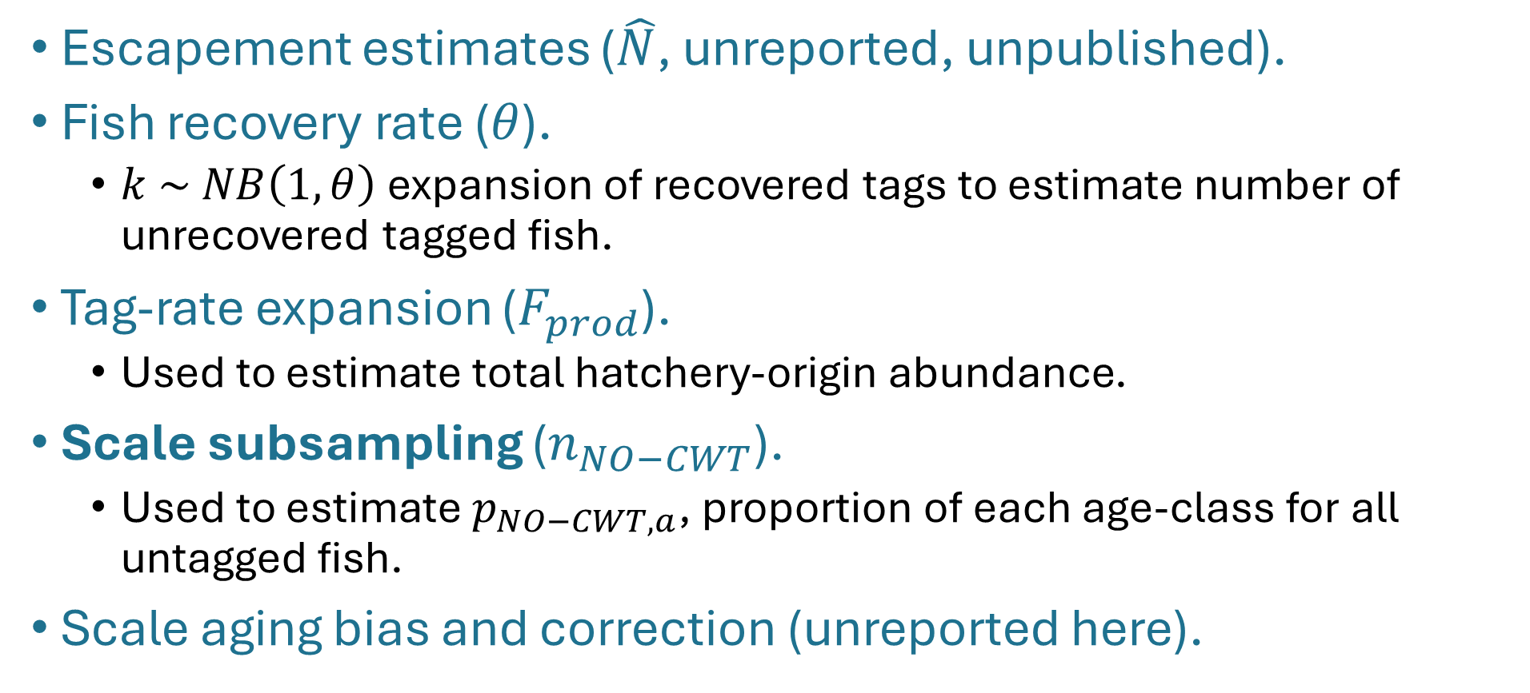
CR sources of uncertainty
Escapement estimates ($\hat{N}$, unreported, unpublished).
Fish recovery rate ($θ$).
$k \sim NB\left(1,θ\right)$ expansion of recovered tags to estimate number of unrecovered tagged fish.
Tag-rate expansion ($F_{prod}$).
Used to estimate total hatchery-origin abundance.
Scale subsampling ($n_{NO−CWT}$).
Used to estimate $p_{NO−CWT,a}$, proportion of each age-class for all untagged fish.
Scale aging bias and correction (unreported here).
Notes:
There are several sources of uncertainty that impact the precision and accuracy of our natural-origin escapement estimates:
Currently, we do not report the uncertainty of our escapement estimates. I don’t want to keep hammering on this point, but we can, and we should, be publishing this metric. This is probably the easiest update that we could implement that could have huge downstream effects for SFCS modeling efforts. Of course it’s a little beyond my influence to implement, but I think if we had a good management push we could make it happen.
There is inherent uncertainty in the recovery of fish at non-hatchery locations. We can’t get hands on all the fish available at to carcass or angler surveys, but increasing fish recovery rate decreases uncertainty in estimate of fish abundance and tagged fish abundance.
Our hatchery release tagging rate is also a source of uncertainty and increasing the tagging rate decreases uncertainty in estimate of natural-origin abundance.
The number of scales we select for aging also impacts the precision of our cohort estimates, so increasing scale subsampling decreases uncertainty in age estimates. This is the focus of our work here.
Finally, there is uncertainty in the scale aging process, which is addressed through bias correction using confusion matrices, which will not be discussed here.

Slide 5
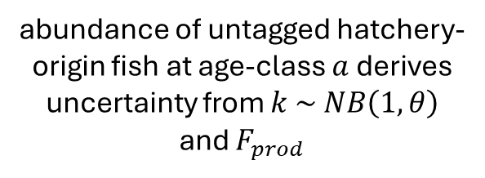

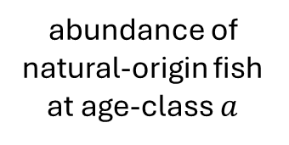
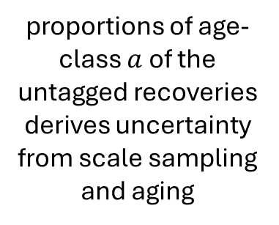
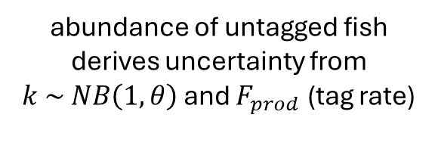
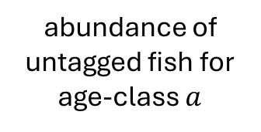
How uncertainty is incorporated
abundance of untagged fish derives uncertainty from $k \sim NB\left(1,θ\right)$ and $F_{prod}$ (tag rate)
proportions of age-class $a$ of the untagged recoveries
derives uncertainty from scale sampling and aging
$${{\hat{N}}_{NO−CWT,a}=\hat{N}}_{NO−CWT}∗p_{NO−CWT,a}$$
${\hat{N}}_{no,a}={\hat{N}}_{NO−CWT,a}−{\hat{N}}_{NO−CWT,ho,a}$
abundance of untagged fish for age-class $a$
abundance of untagged hatchery-origin fish at age-class $a$ derives uncertainty from $k \sim NB\left(1,θ\right)$ and $F_{prod}$
abundance of natural-origin fish at age-class $a$
Notes:
To better understand how the uncertainty of tag-rate, theta, and scale samples impacts our estimates there are two equations worth reviewing. The first is our estimate of the abundance of untagged fish in each age class a, which is calculated by multiplying our estimate of the abundance of total untagged fish in the population by the proportion of each age-class from the aging of untagged scales. This estimate of untagged fish for each age-class is influenced by the uncertainty around our sampling, so lower theta and tag-rate values makes our estimate less certain, as well as the uncertainty from our scale subsample, so a smaller scale sample size makes our estimate less certain. We then take that estimate for the abundance of untagged fish for age-class a and subtract from it the estimate of abundance of untagged hatchery-origin fish at that age-class, which also get its uncertainty from theta and the tag rate. So our scale sample size impacts our estimate of the proportion of each age-class among the untagged fish in the population, our theta and tag rate affect our estimate of untagged fish abundance and hatchery-origin abundance. Altogether they impact our estimate of abundance or proportion of natural-origin fish in each age-class.

Slide 6


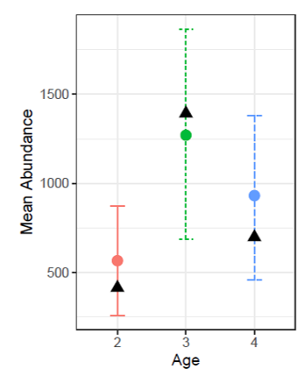
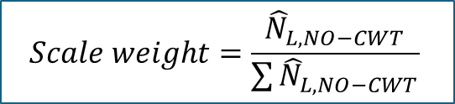
Weighted pooling of untagged scales
L1
L2
L3
L4
recovery
Weight scale samples
$$Scale weight=\frac{{\hat{N}}_{L,NO−CWT}}{\sum{{\hat{N}}_{L,NO−CWT}}}$$
Pooled scale-sampling
Basin-wide estimate
Notes:
I’m not going to go through the whole process of the analysis and simulations I ran, but the will instead briefly cover the results that we discussed at our last meeting and the follow up notes I sent later.
After running a bunch of bootstrapped simulations using methods based on Emily Chens work, I found that the most accurate method to select scales for aging is to weight the number of scales needed from each sampling location by their contribution to the total basin wide number of untagged fish. These scales from across survey locations are then pooled together for a basin-wide estimate.

Slide 7
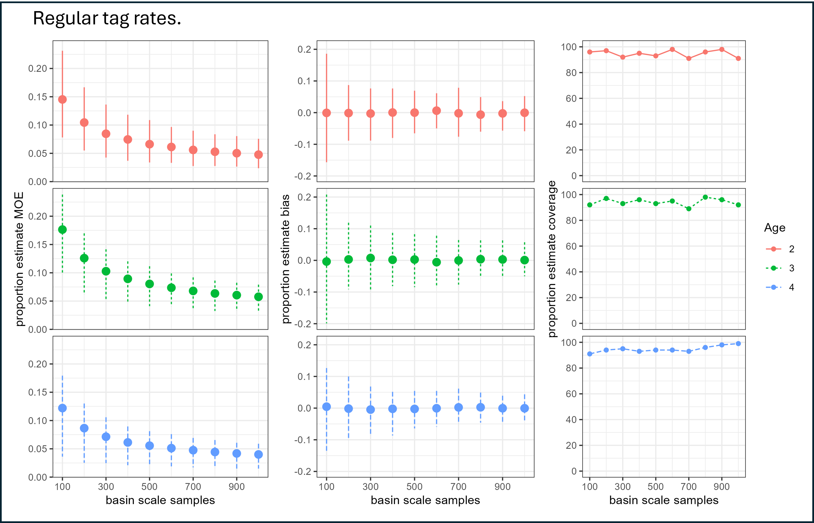
Notes:
Running a bunch of different simulations using this method, I found that 500 scales is a good minimum that provides an unbiased estimate within a 10% margin of error that accurately includes the true values around 95% of the time.
Proportion estimate coverage = in what proportion of our simulations was the true value within the estimated confidence intervals?

Slide 8
Scale collection outline
Scale collection from escapement surveys.
Estimating survey location abundance.
Estimating locations contribution to basin abundance.
Selection of scales for aging.
Pooling and aging scales from across the basin.

Slide 9
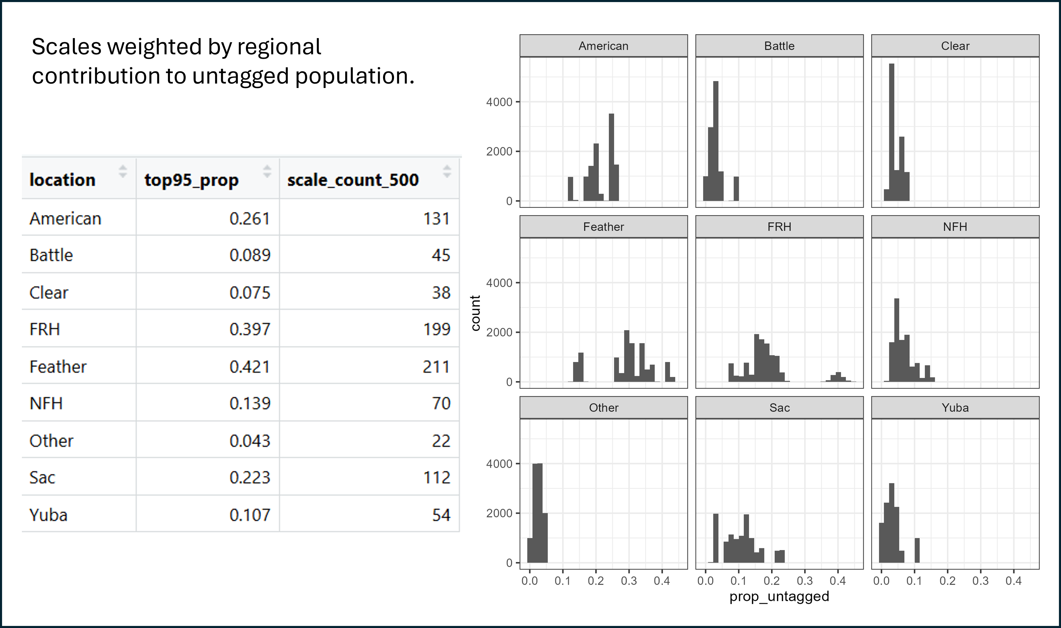
1) Scale collection
Notes:
The next question before implementation is how many scales does each region need to collect to contribute to the basin estimate?
Based on historical tag counts and k-draws replications I estimated a target number of scales to collect for nine-different sampling regions. This is based on the 95th percentile proportional contribution to the basin-wide untagged population from each location. These estimates represent a relative maximum that surveys should aim to collect and pass on to pooled aging.

Slide 10
1) Scale collection
Important caveat:
Ensure surveys are not front-loading scale collection.
Example: For the Feather R. we need 211 scales from untagged fish. That could likely be collected in the first week or two, but “front-loading” the samples could bias age class estimates.
How best to do this?
Just collect scales from all untagged fish.
Inefficient, could be unwieldy in the hatcheries or rivers with large returns.
Ensure some minimum collected each week.
However, need to balance scale selection by weekly abundance. Otherwise, we can bias age-class estimates.
Consider collecting scales from every k-th fish encountered.
Record timing of every scale collected for later stratification if necessary.
Notes:
Weekly balance example: if for a given location we collect 50 scales each week for 10 weeks, for a total of 500 scales. At the end of the season we only need 200 scales, so we select 20 scales from each week. But what if the peak of the run is at the mid-point of the survey season, and age 2 fish mostly return in those middle two weeks, but the age 3 and 4 fish are evenly distributed across the survey period. We could end up underestimating the proportion of age 2 fish in the population.

Slide 11
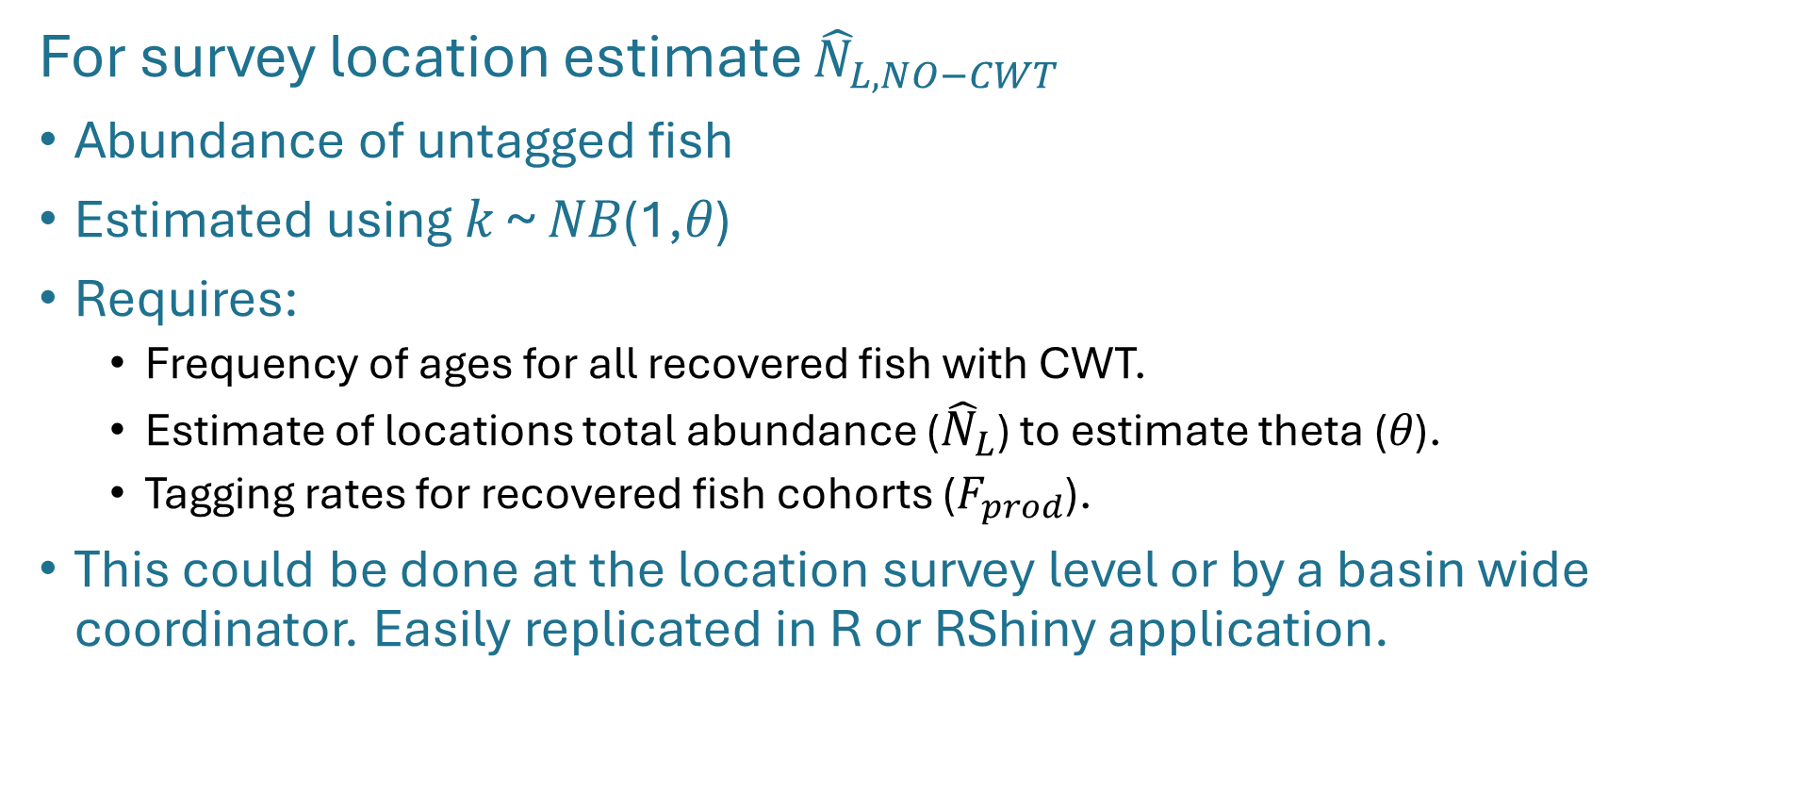
2) Estimate abundance of untagged fish
For survey location estimate ${\hat{N}}_{L,NO−CWT}$
Abundance of untagged fish
Estimated using 𝑘 ~ 𝑁𝐵(1,𝜃)
Requires:
Frequency of ages for all recovered fish with CWT.
Estimate of locations total abundance (${\hat{N}}_{L}$) to estimate theta (𝜃).
Tagging rates for recovered fish cohorts ($F_{prod}$).
This could be done at the location survey level or by a basin wide coordinator. Easily replicated in R or RShiny application.
Notes:
Once the scales are collected for a given location, we need an estimate of the abundance of untagged fish for that location. Historically this was done using tag rate expansions, but that method did not incorporate uncertainty estimates. Here we can use the k-draw method laid out by E. Chen that allows us to describe the uncertainty in our estimate.
This requires:
the number of tagged fish in each age class
an estimate of the locations total abundance, which can give us our sampling rate (theta)
The tagging rate for the recovered fish cohorts. Note that there may be multiple tagging rates for each location if fish from different hatcheries/cohorts are recovered.
This estimate of untagged fish abundance could easily be done at the local level, or by a basin-wide coordinator for each location.

Slide 12
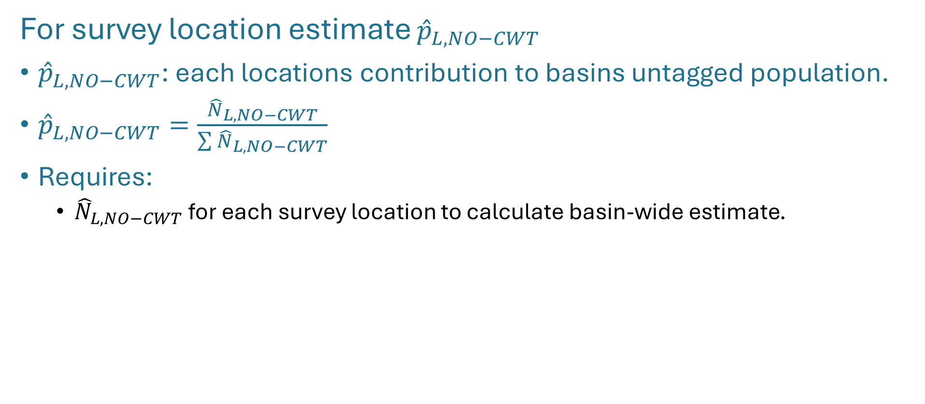
3) Estimate locations contribution to basin
For survey location estimate ${\hat{p}}_{L,NO−CWT}$
${\hat{p}}_{L,NO−CWT}$: each locations contribution to basins untagged population.
${\hat{p}}_{L,NO−CWT}=\frac{{\hat{N}}_{L,NO−CWT}}{\sum{{\hat{N}}_{L,NO−CWT}}}$
Requires:
${\hat{N}}_{L,NO−CWT}$for each survey location to calculate basin-wide estimate.
Notes:
Once each location has produced an estimate of the abundance of untagged fish for their survey, we can sum those across the entire Sac River basin. This allows us to calculate each locations proportional contribution to the basins untagged population.
Of course this requires all the survey locations to report in their estimates, so it will require some amount of coordination across the basin.

Slide 13
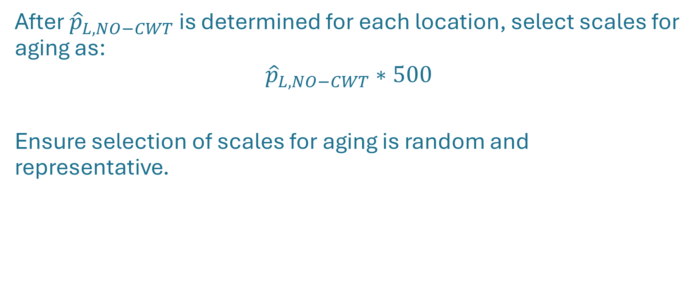
4) Randomly select scales for aging
After ${\hat{p}}_{L,NO−CWT}$ is determined for each location, select scales for aging as:
$${\hat{p}}_{L,NO−CWT}∗500$$
Ensure selection of scales for aging is random and representative.
Notes:
Next, we can calculate the number of scales to age from each location as part of the pooled basin wide estimate. This is calculated as the proportion of each locations contribution to untagged fish in the basin multiplied by our target scale sample size of 500.

Slide 14
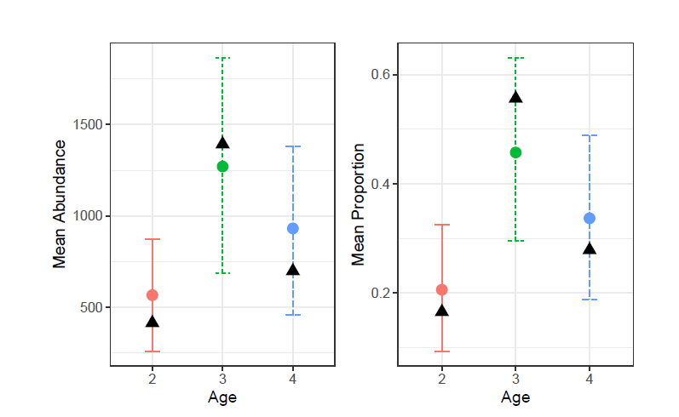
5) Pool and age scales
Pool a minimum of 500 selected scales from across Sac R. basin.
Age scales, correct for aging bias.
Estimate abundance of natural origin fish for each age-class for the basin.
Natural origin escapement by age class
$${\hat{N}}_{no,a}={\hat{N}}_{NO−CWT,a}−{\hat{N}}_{NO−CWT,ho,a}$$
Notes:
When all 500 scales are collected and pooled from across the basin, they can be aged and corrected for aging bias. Then using this subsample of aged scales we can estimate the abundance of natural origin fish for each age-class for the whole Sac R. basin.

Slide 15

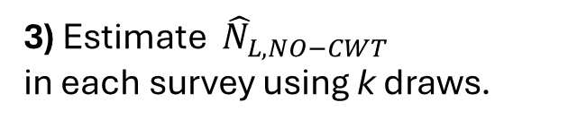

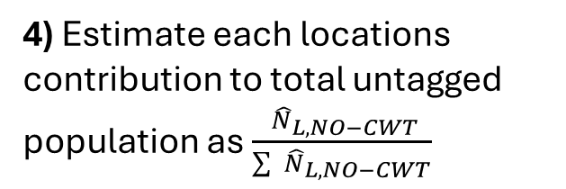
American R.
1) Escapement surveys
2) Collect scales based on historical top 95% contributions
131 scales
3) Estimate ${ \hat{N}}_{L,NO−CWT}$
in each survey using k draws.
${ \hat{N}}_{NO−CWT}$=1500
4) Estimate each locations contribution to total untagged population as $\frac{{ \hat{N}}_{L,NO−CWT}}{\sum{{ \hat{N}}_{L,NO−CWT}}}$
${\hat{p}}_{NO−CWT}$= 1500 / 7500= 20%
5) Select 500 scales for aging
0.2*500=100
6) Pool scales for basin wide estimate
Basin-wide estimate

Slide 16
Scale Sampling Next Steps
Create memo on scale sampling/aging methods.
Arthur + Vanessa
Higher level focus on methods, referencing, but not reiterating, simulation analysis and findings.
Determine best method for teams to ensure scale collection is representative of total population.
Support PBT integration into CR work.

